Slide 1
Assembly Language Lecture #4: Arithmetic
Notes prepared for COMP 7615 (Carly Orr)
References and select slides from:
Computer Organization and Architecture (Stallings, 2016)
Structured Computer Organization (Tanenbaum, 2013)
http://www.nasm.us/doc/nasmdoc3.html (NASM Document)

Slide 2
Test Your Understanding
Is NASM case sensitive?
What is the difference between MOV ax, foo versus MOV ax, [foo]?
How many bytes will this data declaration generate? (hint: “times” means allocate 10 words, each initialized to zero).
table times 10 dw 0

Slide 3
Review:
→ x86 registers (week2 slides)
→ addressing modes (week3 slides)
Arithmetic
→ must recognize registers

Slide 4
Arithmetic – “add” and “sub”
Both instructions can be used for a pair of signed numbers, or a pair of unsigned numbers.
- two’s complement advantage
- no mixing signed and unsigned
CPU has no idea if signed or unsigned
- you keep track
- cpu happily add whatever registers together using binary addition
Some flags may be set, as a result:
the carry bit
the overflow bit
the zero bit (=1 if result is zero)
the sign bit (=1 if result is negative)

Slide 5
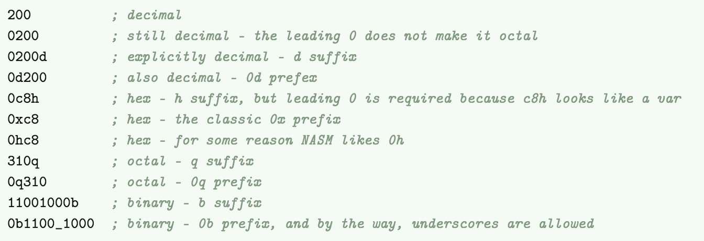
Immediate Addressing
Data has a constant value, or an expression.
Typically, first operand is register or memory location, and second operand is immediate.
First operand defines length of data.
Examples: ADD var, 65 ;an immediate operand 65 is added
MOV AX, 45h ;immediate constant 45h is transferred
Immediate data forms:

Slide 6
Overflow?
What is it?
When data is “out of range”
A register has “limited number of bits”
It is your job to check!!
How do we detect overflow?
For unsigned numbers: if carry it is set, we have overflow
For signed numbers: if overflow bit is set, we have overflow

Slide 7
Multiplication
mul
Unsigned number multiplication
Imul
Signed number multiplication
Why two instructions?
Consider the multiplication of FF by FF - If we assume unsigned quantities, this is 255*255 = 65035 = FE0Bh
- If we assume signed quantities, this is -1 * -1 = 1 = 0001h

Slide 8
The “imul” instruction
Imul, which is used for signed numbers, has three formats:
imul src
imul dst, src1
imul dst, src1, src2

Slide 9
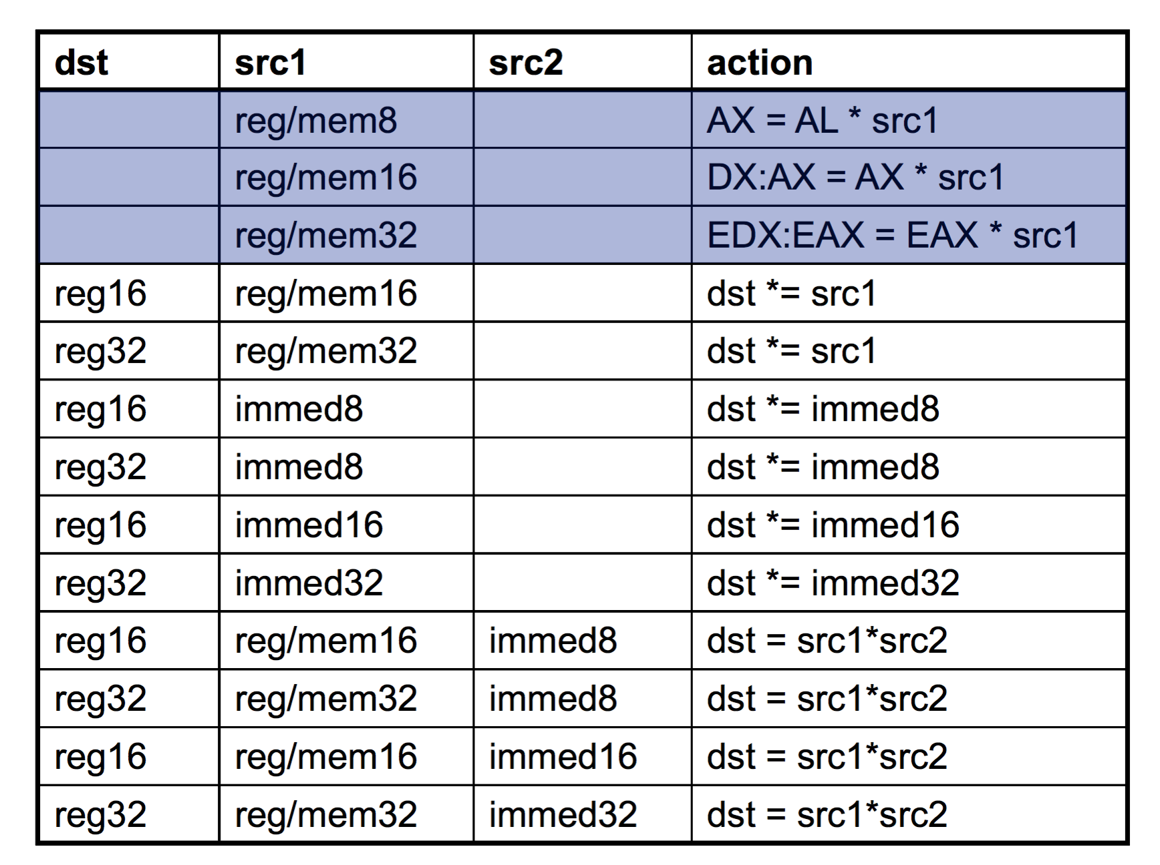

Slide 10
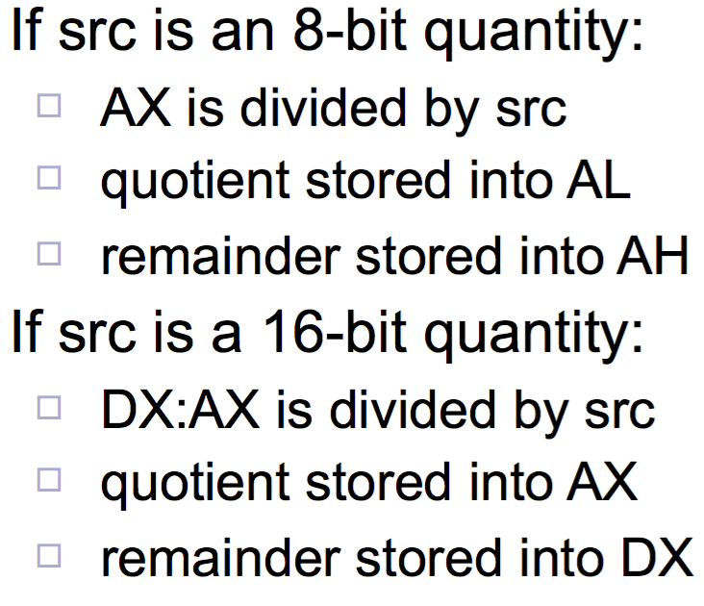
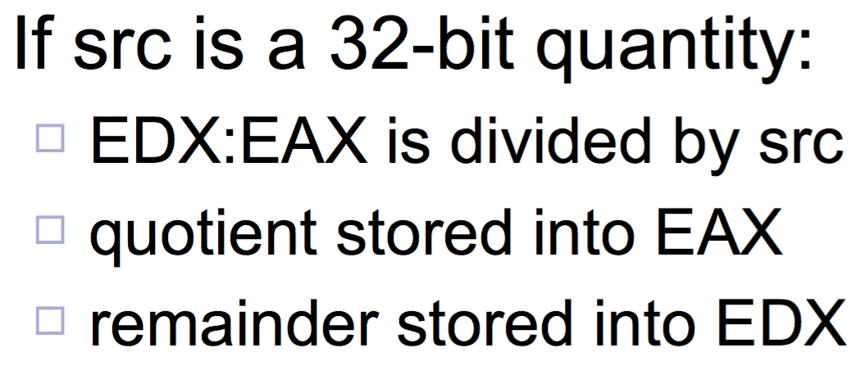
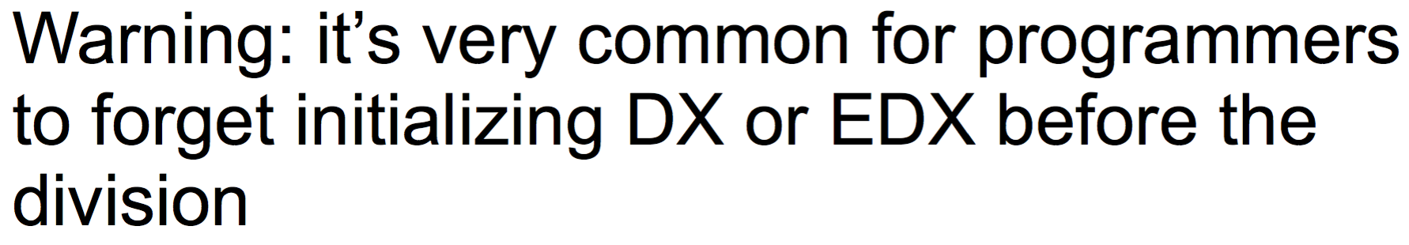
Division – integer division
div
Unsigned number multiplication
idiv
Signed number multiplication
Format:
div/idiv src
Example:
19/4 produces
quotient 4
remainder 3

Slide 11
Negation
neg
Computes 2’s complement
Works on 8, 16, 32 bit
Works on registers or memory

Slide 12
Conclusion
One must be careful doing arithmetic because the CPU happily produces results, but it may be “bogus”.
Check your carry and overflow bits!

